Slide 1
Introduction
Name: Faraz Ahmad
Roll No: 2020-CS-144
Department of Computer Science

Slide 2

Education in the time of pandemic
>1.2 billion
574 million in the Commonwealth
Affected by institutional closures

Slide 3

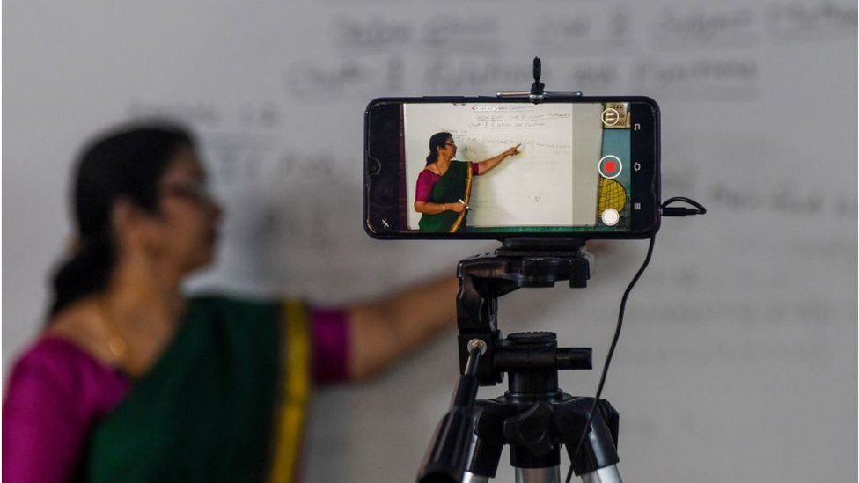
How has the coronavirus impacted the classroom?
The coronavirus has disrupted education across the globe.
Teachers cannot meet with students, and parents are caring for kids at home. A HUGE CHALLENGE!

Slide 4
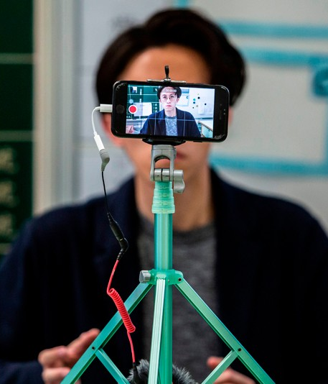
How teachers have suffered
Issues
Connectivity, costs and electricity
Access to online platforms
Quality Content
Capacity of teachers

Slide 5
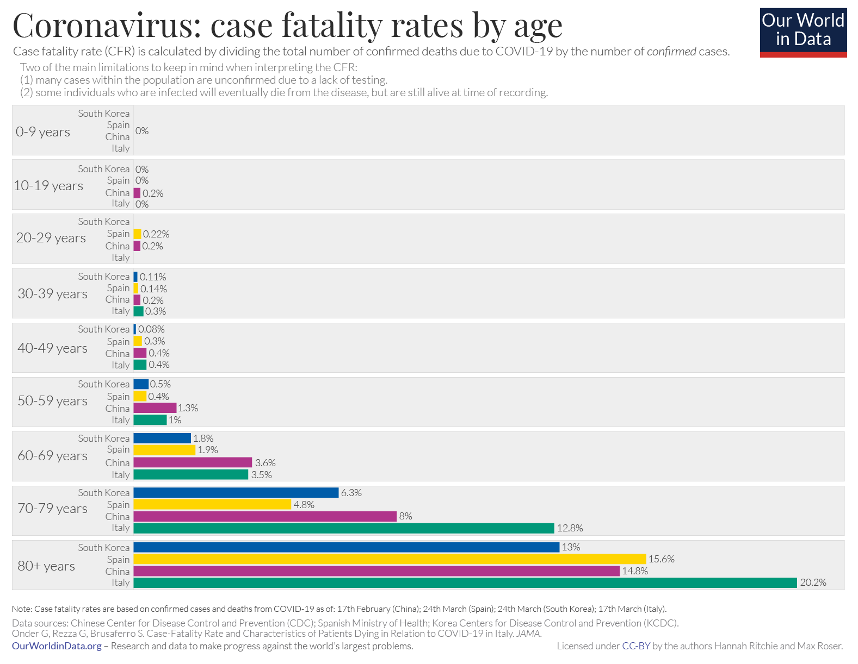
TEACHERS AT RISK!
CORONAVIRUS: Case fatality rates by age
Source: Chinese Center for Disease Control and Prevention

Slide 6
Growth of ICTs: Mobile subscriptions
Source: data.worldbank.org, retrieved on 17 January 2020

Slide 7
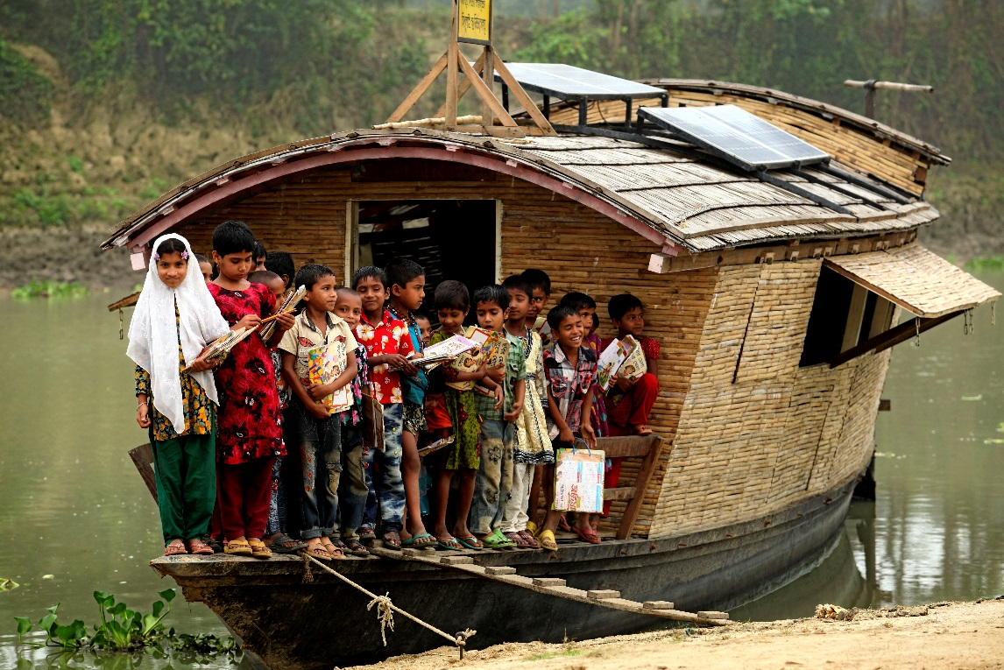
Photo credit: Abir Abdullah / Shidhulai Swanirvar Sangstha. Bangladesh

Slide 8
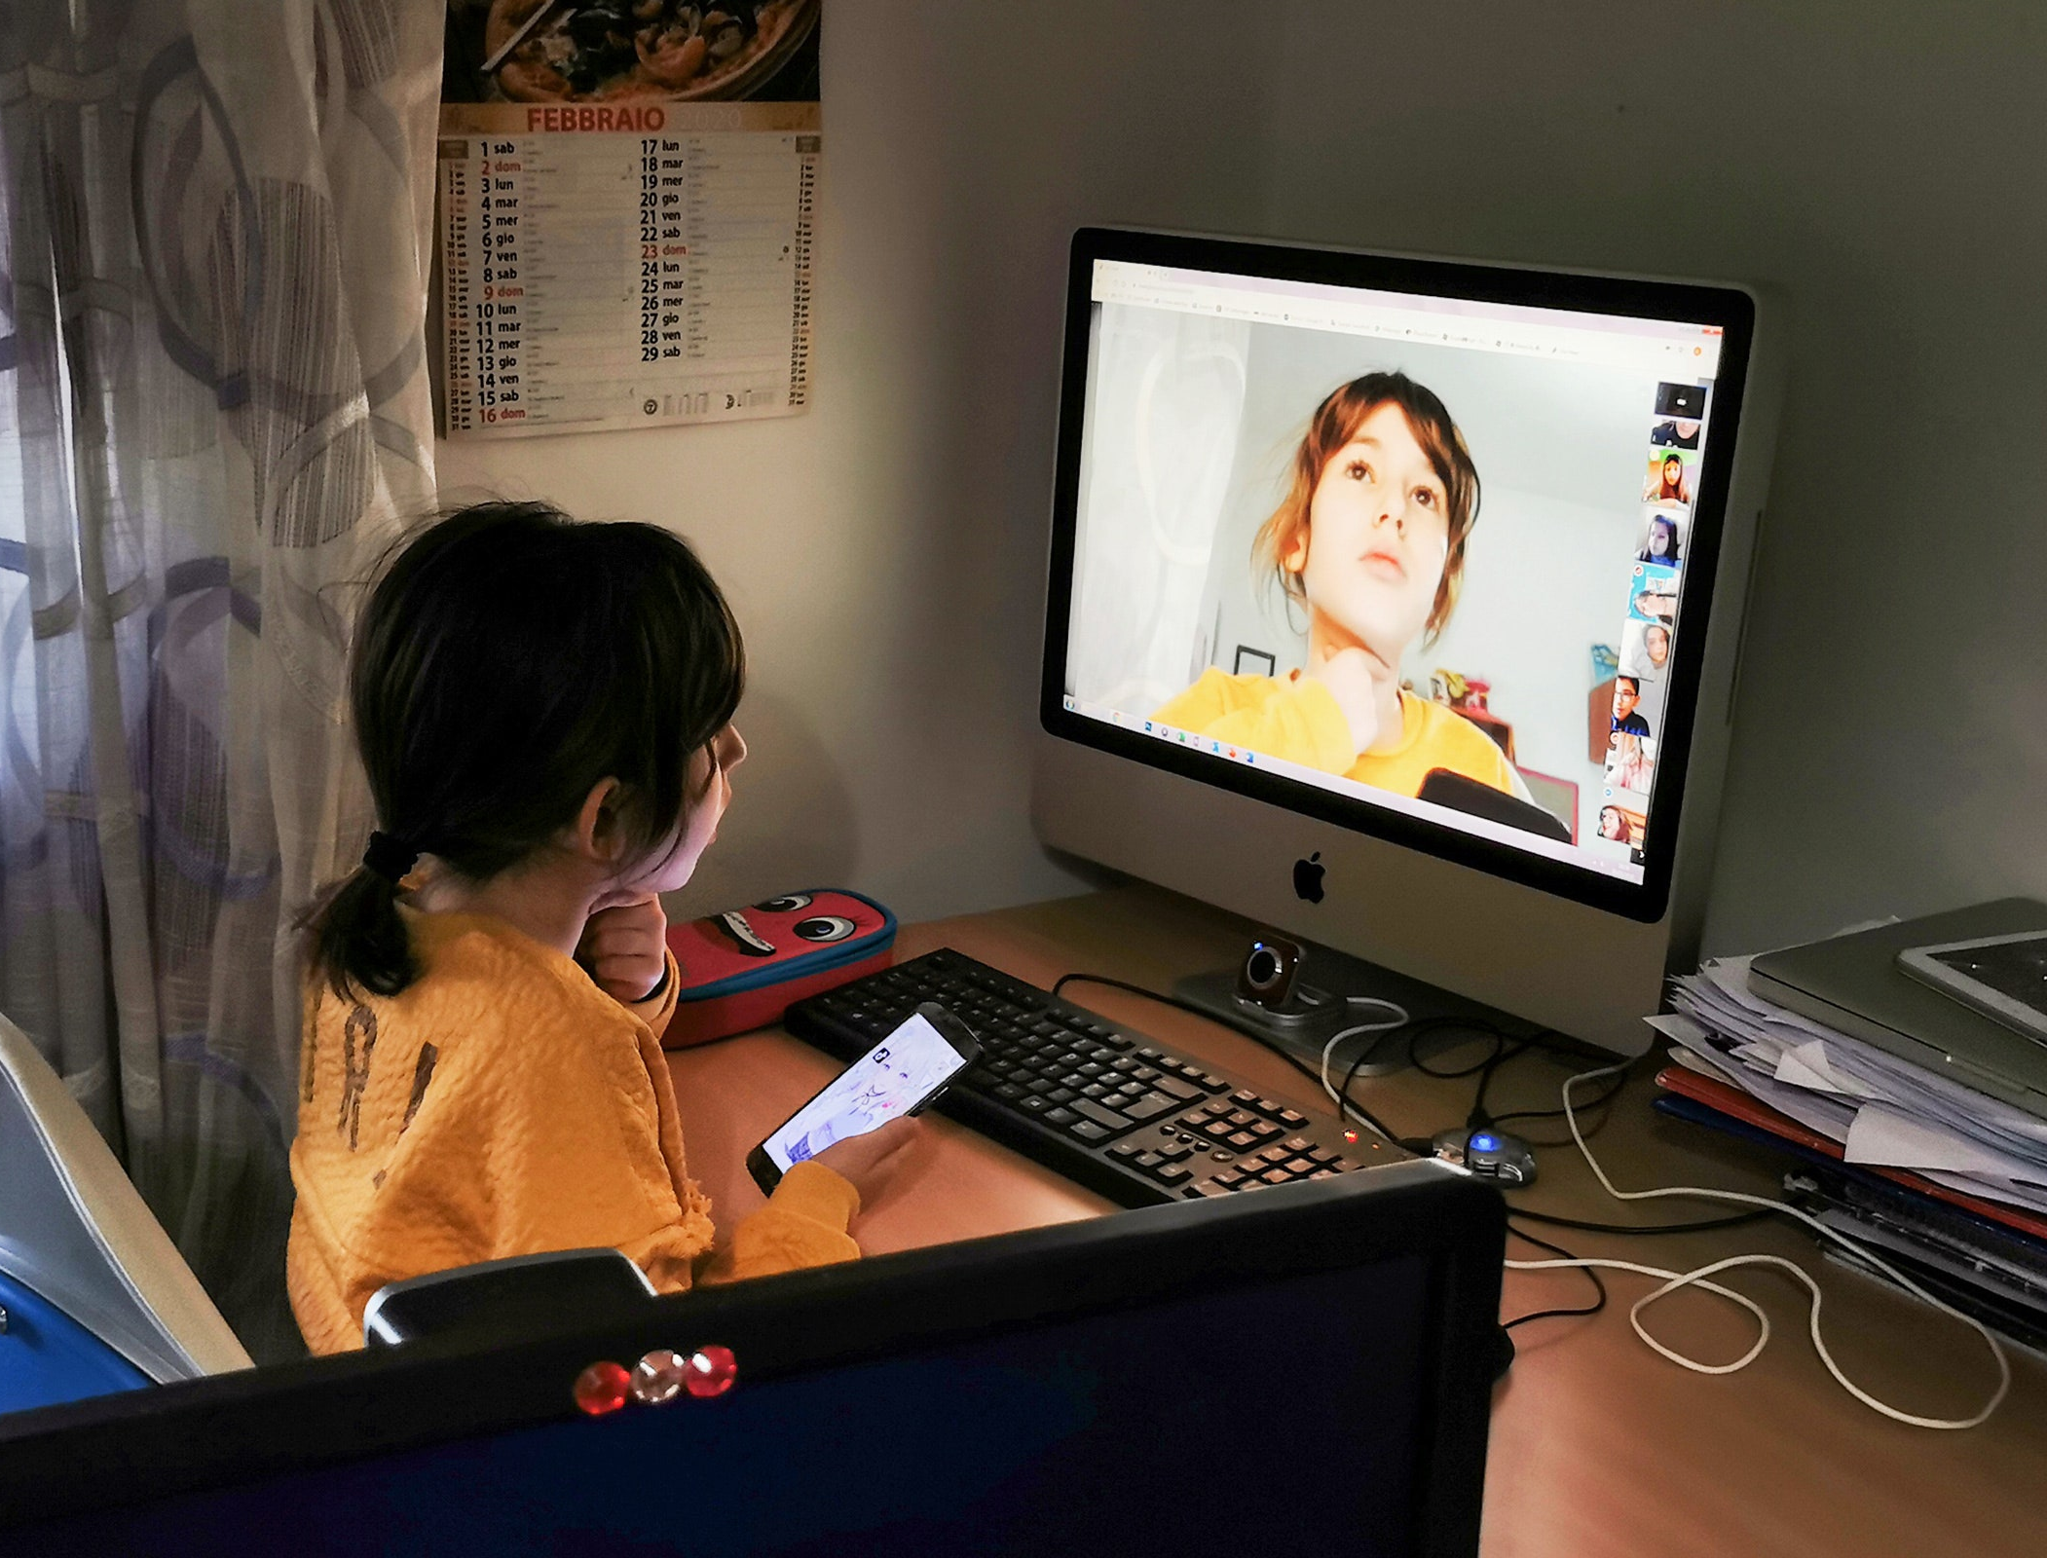

Slide 9
How is COVID-19 affecting student learning?
The impact of COVID-19 on student achievement and what it may mean for educators
Teachers are scrambling to adapt content for an online platform
Parents are juggling work responsibilities
Students themselves are faced with isolation, anxiety about a deadly virus, and uncertainty about future.

Slide 10

Lose-lose situation
“Sometimes you win and sometimes you learn”

